Slide 1
COMBINATIONAL LOGIC

Slide 2
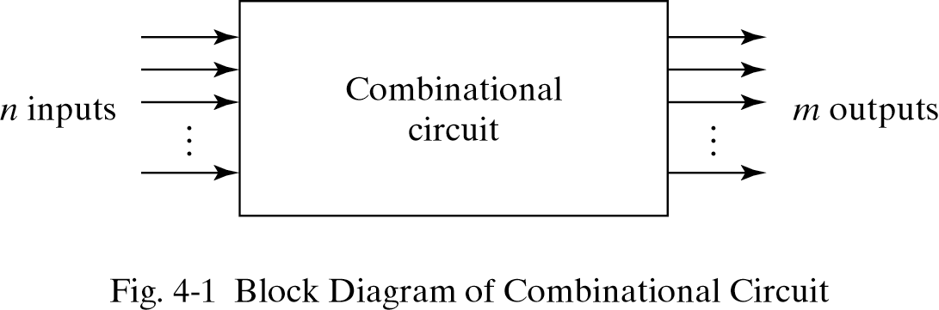

Slide 3
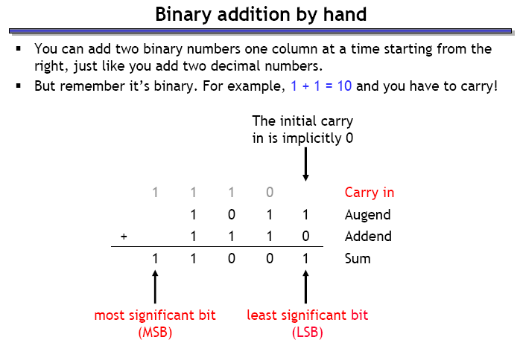

Slide 4
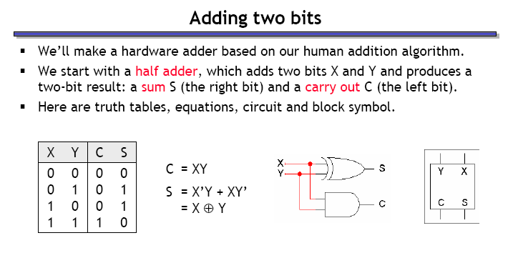
HALF ADDER

Slide 5
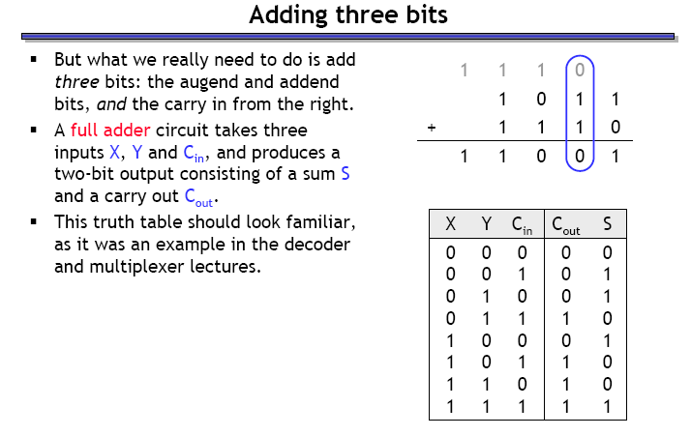
FULL ADDER

Slide 6
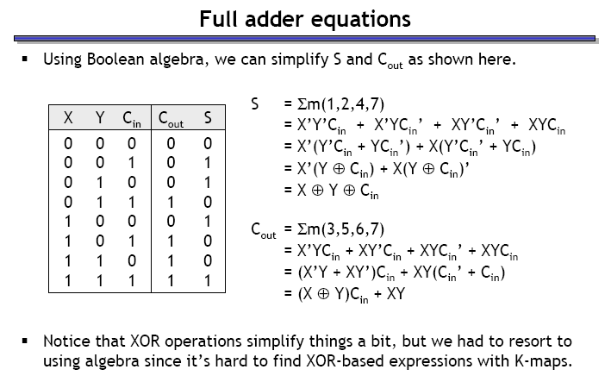

Slide 7
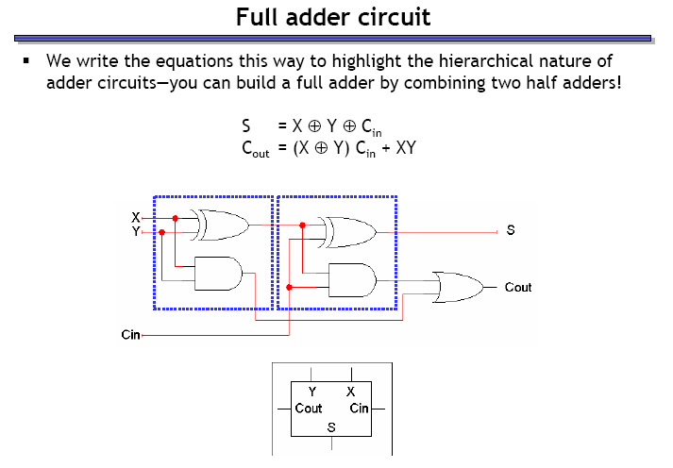

Slide 8
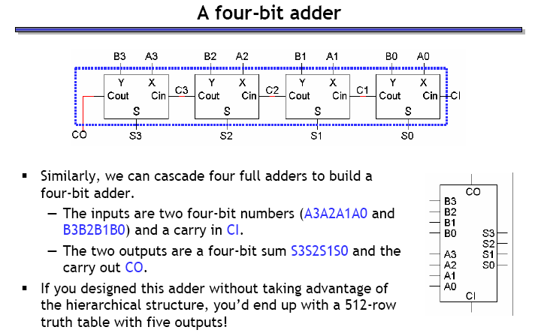

Slide 9
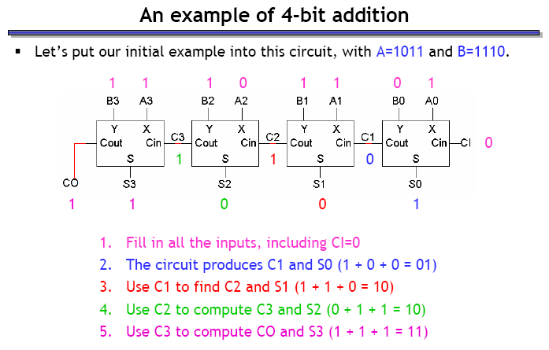

Slide 10
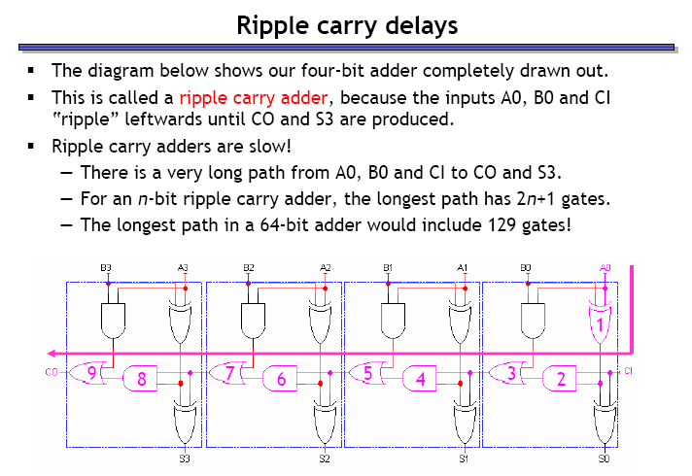

Slide 11
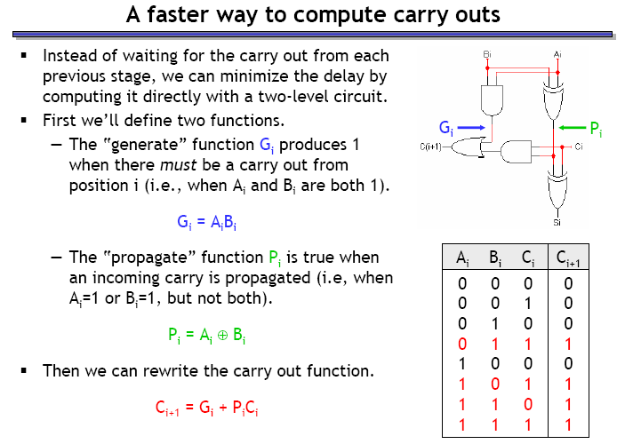

Slide 12
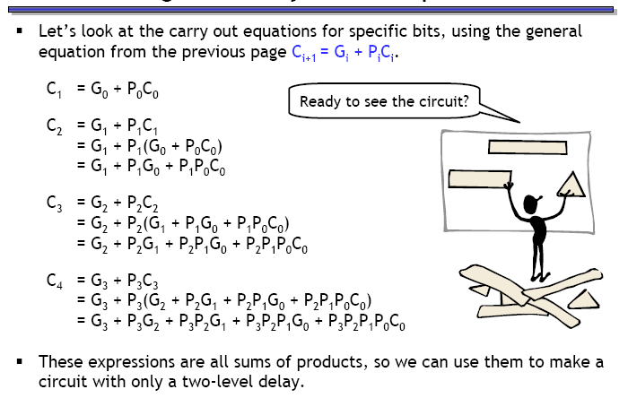

Slide 13
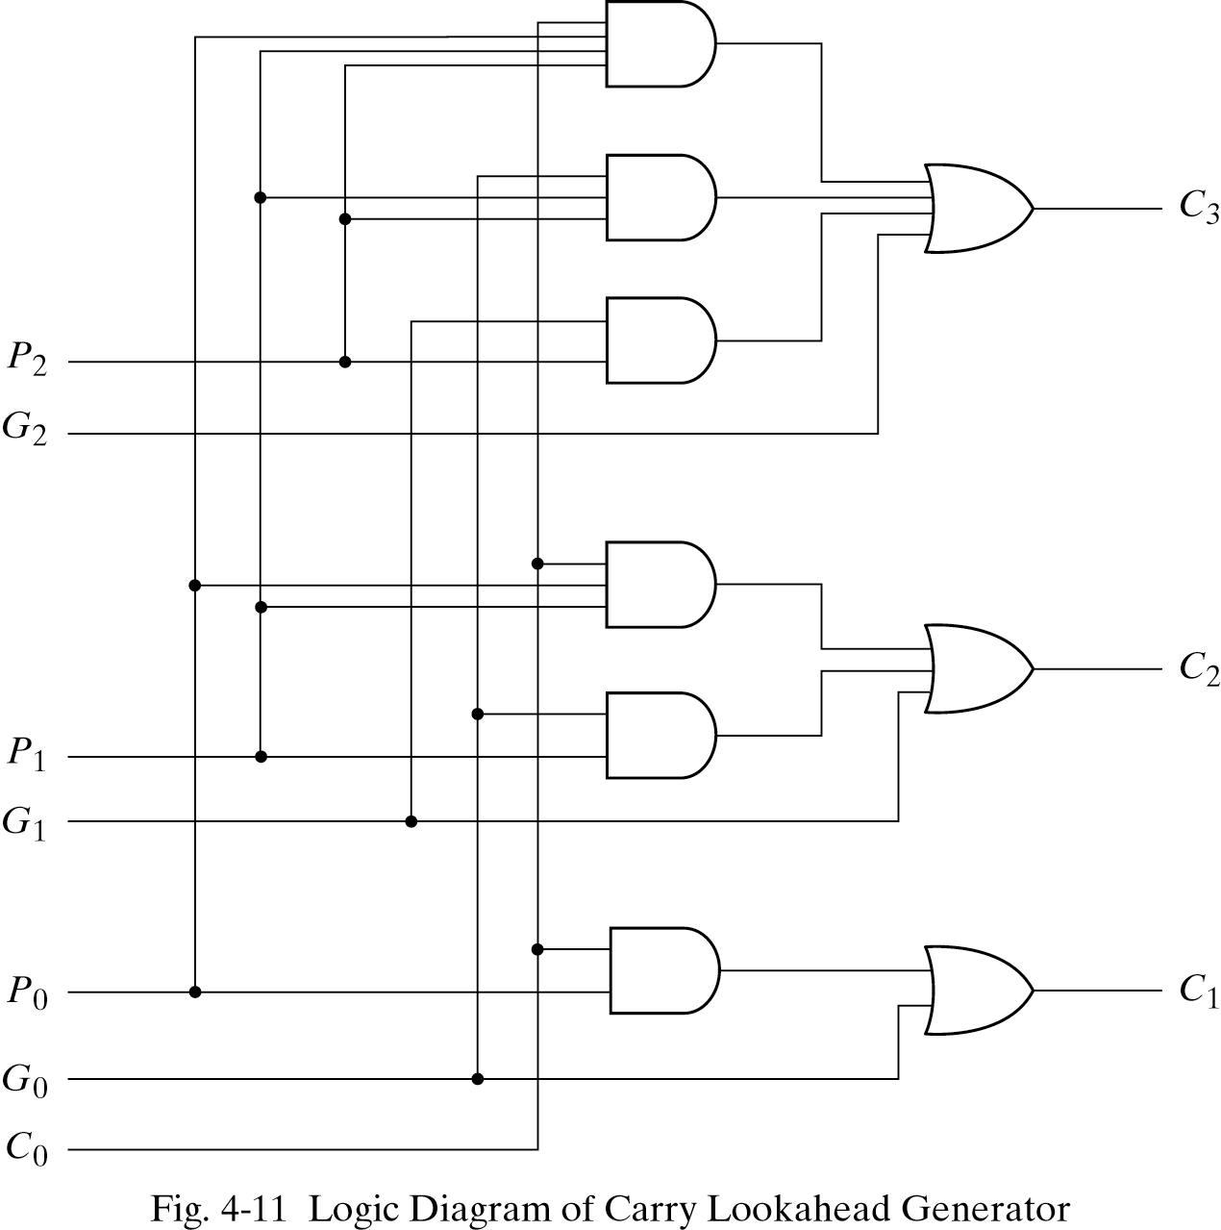

Slide 14
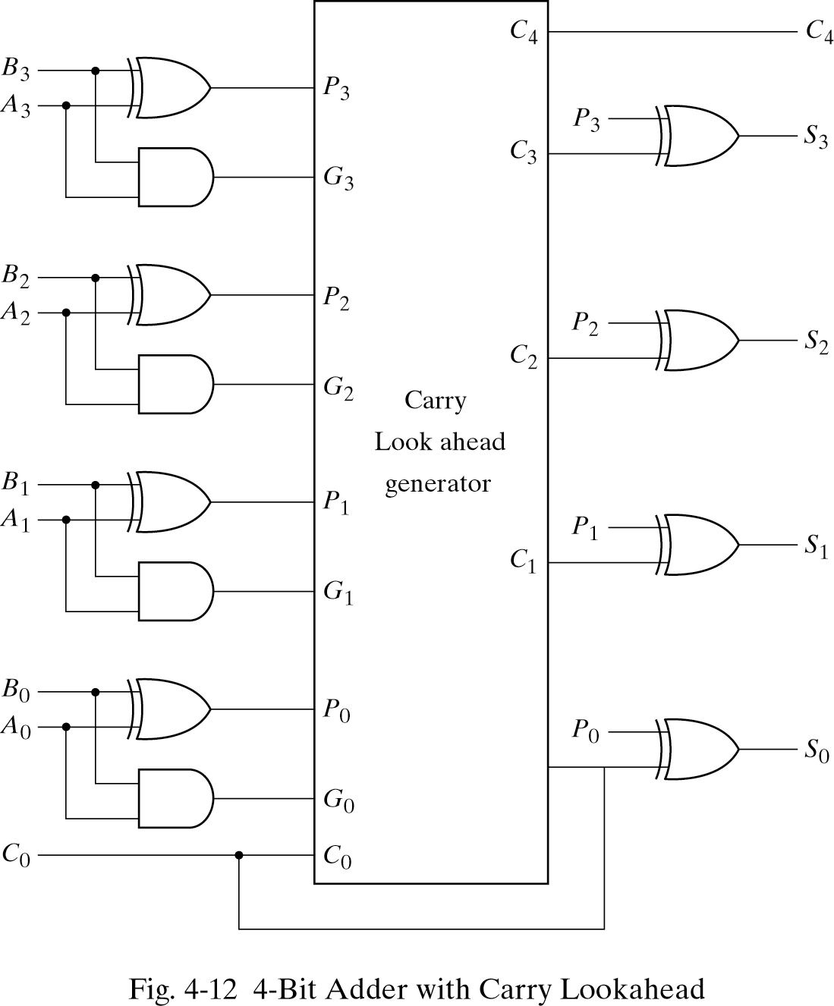

Slide 15
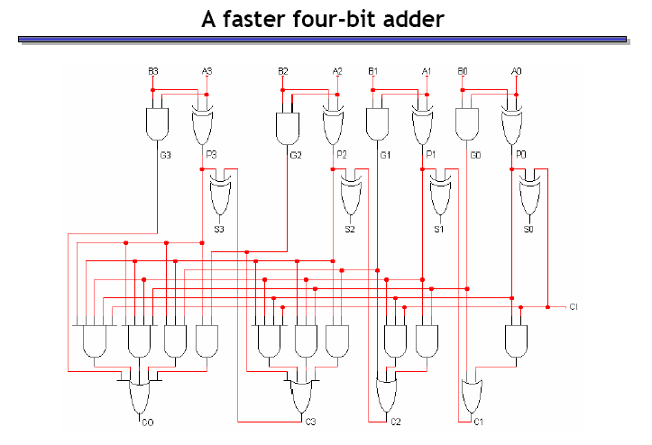

Slide 16
Binary Adder/Subtractors
The subtraction A-B can be performed by taking the 2's complement of B and adding to A.
The 2's complement of B can be obtained by complementing B and adding one to the result.
A-B = A + 2C(B)
= A + 1C(B) + 1
= A + B’ + 1

Slide 17
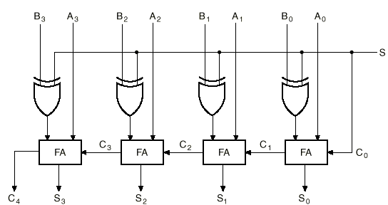
4-bit Binary Adder/Subtractor
XOR gates act as programmable inverters

Slide 18
4-bit Binary Adder/Subtractor (cont.)
When S=0, the circuit performs A + B. The carry in is 0, and the XOR gates simply pass B untouched.
When S=1, the carry into the least significant bit (LSB) is 1, and B is complemented (1’s complement) prior to the addition; hence, the circuit adds to A the 1’s complement of B plus 1 (from the carry into the LSB).

Slide 19
4-bit Binary Adder/Subtractor (cont.)
S=0
B₃
B₂
B₁
B₀
0
S=0 selects addition
B exor 0 = B

Slide 20
4-bit Binary Adder/Subtractor (cont.)
S=1
B₃’
B₂’
B₁’
B₀’
1
S=1 selects subtraction
B exor 1 =B inverted

